Slide 1
Heat Transfer
Condensation

Slide 2
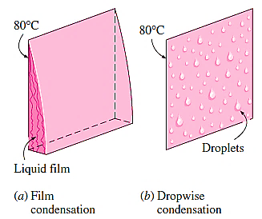
CONDENSATION HEAT TRANSFER
Whenever a saturated vapour at a temperature T_{sat} is brought in contact with a surface maintained at temperature T_{s} such that T_{s} is less than T_{sat} vapours condense on the surface.

Slide 3
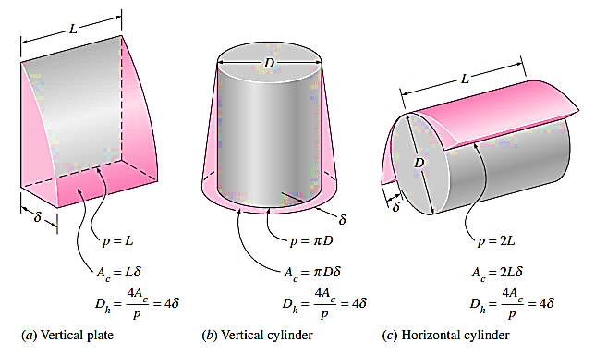
Film Condensation and Flow Regimes
Thickness of the film is zero at the top of the plate and increases as we travel down the plate due to additional condensation of vapour.
Initially, the liquid film flow is laminar; after some distance it will become wavy and later, it may even turn turbulent. These different flow regimes are identified according to a 'film Reynolds number', defined as follows:
$${Re}_{f}=\frac{D_{L} . ρ_{L} .V_{L}}{μ_{L}}$$
$$=\frac{{4 .A}_{c} . ρ_{L} .V_{L}}{P . μ_{L}}=\frac{{4 . }_{ } ρ_{L} .V_{L} .δ}{ μ_{L}}=\frac{4 .m}{P . μ_{L}}$$

Slide 4
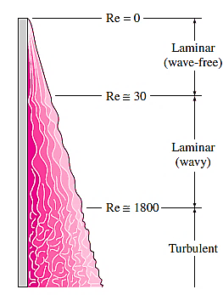
sub-cooling of the liquid can be taken into account by replacing h_{fg} by a 'modified latent heat of vaporisation $h_{fg}^{,}$ defined as:
$$h_{fg}^{,}=h_{fg}^{ }+0.68 C_{pL} (T_{sat}−T_{s})$$
Similarly, if a superheated vapour at a temperature, T_{v}, enters a condenser and condenses, the superheated vapour has to be cooled to T_{sat} first, and then condensed at T_{sat} and then sub-cooled to some temperature between T_{s} and T_{sat} Then, modified latent heat of vaporisation is:
$$h_{fg}^{,}=h_{fg}^{ }+0.68 C_{pL} \left(T_{sat}−T_{s}\right)+C_{pV} (T_{v}−T_{sat})$$
Then, rate of heat transfer in condensation becomes:
$$Q_{conden}=h .A.\left(T_{sat}−T_{s}\right)=m .h_{fg}^{,}$$

Slide 5
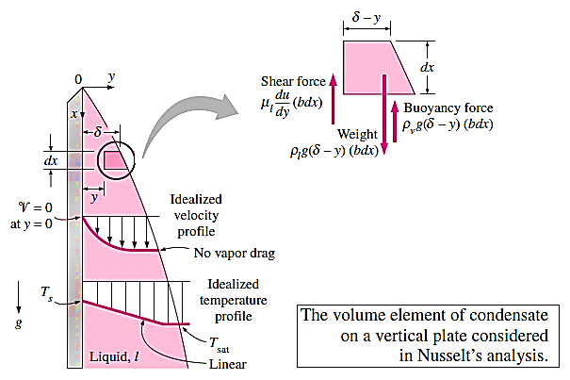
Nusselt's Theory for Laminar Film Condensation on Vertical Plates
Nusselt made the following simplifying assumptions in his analysis:
Flow of liquid film is laminar
Heat flow is mainly by conduction through the liquid film
Temperature is T_{s} at the liquid-plate interface and T_{sat} at the liquid-vapour interface and the temperature gradient between them is linear
Velocity of vapour is low, i.e. there is no viscous shear force at the liquid-vapour interface
Properties of the liquid are constant.

Slide 6
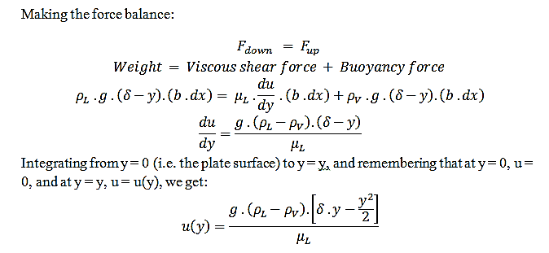
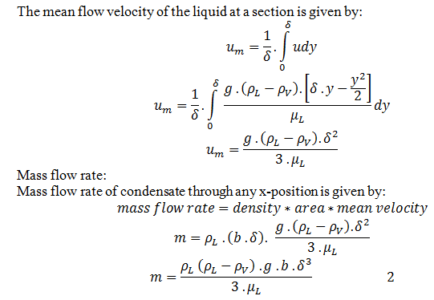

Slide 7
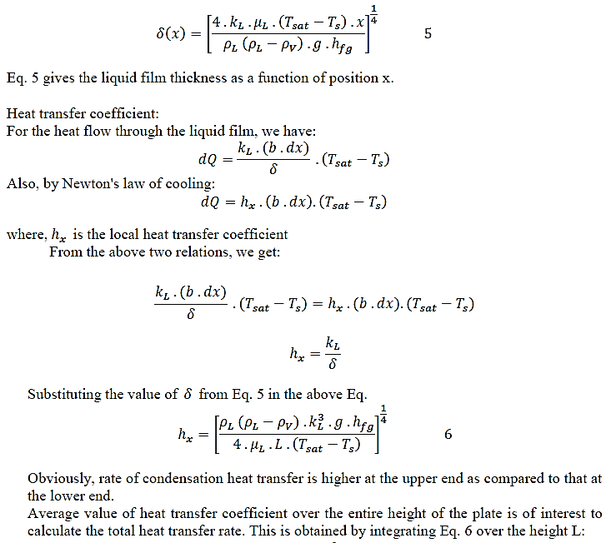

Slide 8
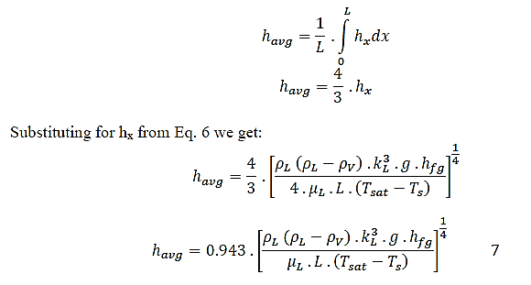
$$h_{avg}=0.943 .{\left[\frac{ρ_{L} \left(ρ_{L}−ρ_{V}\right) . k_{L}^{3} .g .h_{fg}^{′}}{μ_{L} .L .\left(T_{sat}−T_{s}\right)}\right]}^{\frac{1}{4}} 8$$

Slide 9
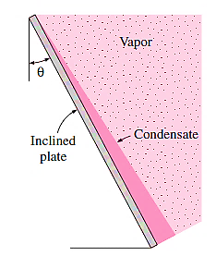
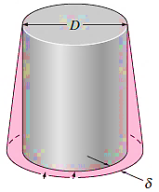
Film Condensation on Inclined Plates, Vertical Tubes, Horizontal Tubes and Horizontal Tube Banks
Inclined plates:
$$h_{inclined}=0.943 .{\left[\frac{ρ_{L} \left(ρ_{L}−ρ_{V}\right) . k_{L}^{3} .g.cos(θ) .h_{fg}^{′}}{μ_{L} .L .\left(T_{sat}−T_{s}\right)}\right]}^{\frac{1}{4}} 9$$
Vertical tubes:
Eq. 8 for laminar condensation on vertical plates can also be used
the outer or inner surface of a vertical tube
. if D >> $δ$

Slide 10
Horizontal tube-laminar film condensation:
$$h_{horiz.}=0.729 .{\left[\frac{ρ_{L} \left(ρ_{L}−ρ_{V}\right) . k_{L}^{3} .g .h_{fg}^{′}}{μ_{L} .D .\left(T_{sat}−T_{s}\right)}\right]}^{\frac{1}{4}}$$
horizontal tubes on a matrix containing N tubes
$$h_{horiz.}=0.729 .{\left[\frac{ρ_{L} \left(ρ_{L}−ρ_{V}\right) . k_{L}^{3} .g .h_{fg}^{′}}{μ_{L} .N.D .\left(T_{sat}−T_{s}\right)}\right]}^{\frac{1}{4}}$$

